Slide 1
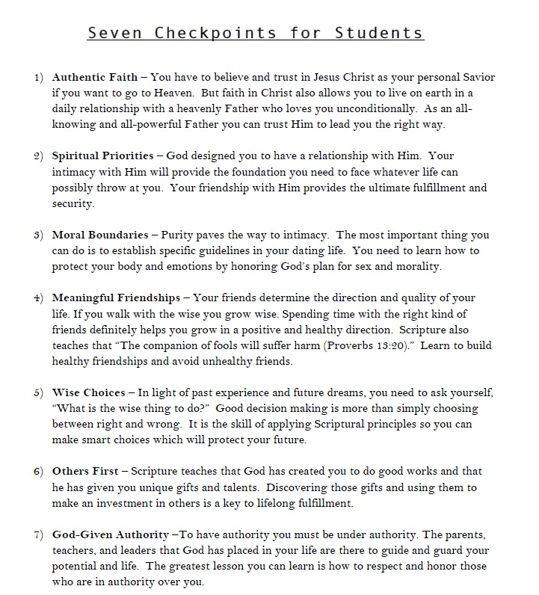

Slide 2
Ungodliness & Unthankfulness Respectable Sins Study

Slide 3
Sins We Don’t Notice – Subtle Sins
Resentment
Gossip
Speaking Critical of others
Being Selfish
Failing to Trust God
Materialism
Unintended Idolatry
Not Caring
Language (Offensive, unintentional, cursing)
Others????

Slide 4
The Remedy?
The Gospel utilizes our hearts to recognize sin in our lives
The Gospel prepares us to face our Sins
The Gospel motivates and energizes us to deal with Sin

Slide 5
ungodliness
We are all guilty of Ungodliness – Probably the most basic Sin
A person may be a nice, respectable citizen and still be an ungodly person.
The difference between ungodliness and unrighteousness
Ungodliness – an attitude (living everyday life with little of no thought of God, His will, His Glory, or the dependence we have on Him!)
Unrighteousness – sinful actions in thought, word, or deed (Romans 1:18)
UNGODLINESS EXAMPLE:
Sinning with the tongue – gossip, sarcasm, unkind words
ALL OTHER “ACCEPTABLE SINS” CAN BE TRACED TO UNGODLINESS

Slide 6
Ungodliness
James 4:13-5
James does not condemn people for making plans, he condemns their failure to depend on God
Are we depending on God in every area of our life?
Are we praying for ourselves, families, and friends in GODs WILL?
Will my activities each day glorify and honor God?
HOW UNGOLDY AM I?
We are not to wait on the Glory of God, but rather run towards it!
Pray God will make us all more aware of our Ungodliness

Slide 7
Unthankfulness
Luke 17:11-19
How could those 9 men be so grateful as to not even turn back and say thank you to Jesus?
Jesus giving us spiritual life is the greatest miracle we can have in our lives
Have you stopped to thank God for the spiritual life Jesus has given you?
Our lives should be a continual act of giving thanks (Acts 17:25)
Deuteronomy 8:11-18
1 Thessalonians 5:18 – Thanks in All Circumstances
Are we to give thanks to God when the circumstances do not turn out as we hoped?
Ephesians 5:20

Slide 8
Dealing with our Sin
1. Address your sin in the context of the Gospel.
2. Learn to rely on the enabling power of the Holy Spirit.
3. Recognize responsibility to take practical steps in dealing with sin
4. Identify specific areas of “acceptable” sin.
5. Seek Applicable Scripture for each of our subtle sins.
6. Pray over the sins you tolerate.
7. Involve others, trusted people in your struggle.

Slide 9
The main idea
Have you been able to notice any attitudes or actions you never regarded as sin?
Have you been able to realize the acceptable sins are still sinful and serious?
UNGODLINESS IS THE ROOT OF OTHER “RESPECTABLE” SINS
UNTHANKFULNESS IS AN ATTITUDE THAT GOD HATES

Slide 10
If God stood in front of you right NOW and told you to do EVERYTHING to His glory, what changes would you immediately make in order to make Him the center focal point of your life?

