Slide 1
The Remedy for Sin & Dealing with our Sin Respectable Sins Study

Slide 3
Sins We Don’t Notice – Subtle Sins
Resentment
Gossip
Speaking Critical of others
Being Selfish
Failing to Trust God
Materialism
Unintended Idolatry
Not Caring
Language (Offensive, unintentional, cursing)
Others????

Slide 4
The Remedy?
The Gospel utilizes our hearts to recognize sin in our lives
The Gospel prepares us to face our Sins
The Gospel motivates and energizes us to deal with Sin

Slide 5
Dealing with our Sin
1. Address your sin in the context of the Gospel.
2. Learn to rely on the enabling power of the Holy Spirit.
3. Recognize responsibility to take practical steps in dealing with sin
4. Identify specific areas of “acceptable” sin.
5. Seek Applicable Scripture for each of our subtle sins.
6. Pray over the sins you tolerate.
7. Involve others, trusted people in your struggle.

Slide 6
Verses Used for this Session!
Isaiah 53:6
Romans 8:31
Isaiah 43:25
Isaiah 53:6
Romans 4:7-8
Romans 8:1
Romans 8:13
Psalm 119:11
Philippians 3:1-11

Slide 7
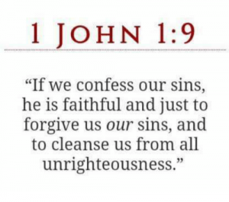
The word confess means to agree with the things Jesus teaches, especially regarding those things that help us live up to our identity as children of God.

