Slide 2
Respectable Sins – Session #4
Anxiety
Frustration
Discontentment

Slide 3
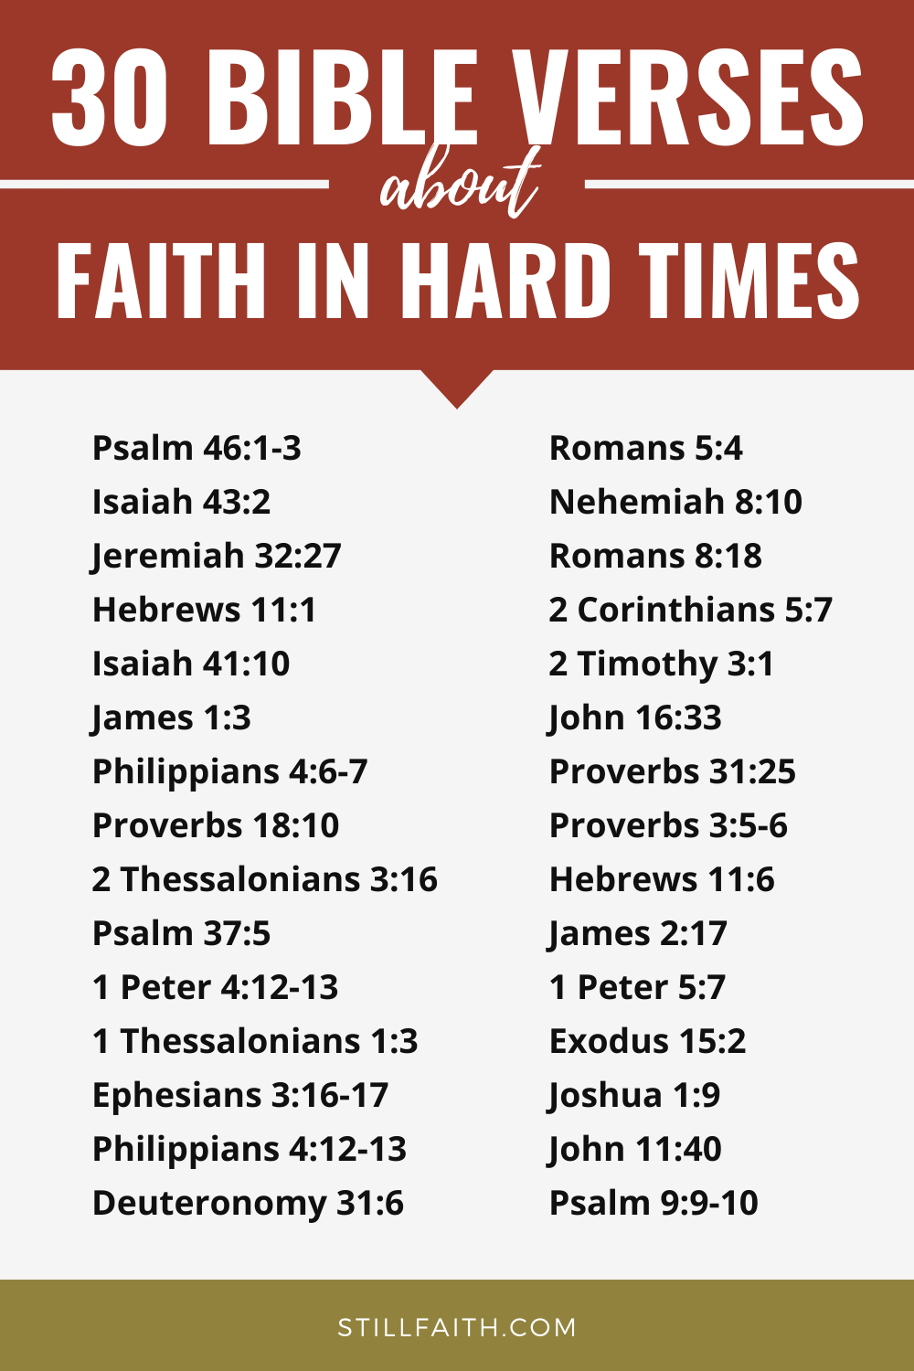
Life – Its Difficult
Car Breaking down while going on a mission trip
Disabilities
Relationships
School
Tests
Allergies
Being told what to do
C O V I D ---

Slide 4
ANXIETY
Philippians 4:2-9
² Now I appeal to Euodia and Syntyche. Please, because you belong to the Lord, settle your disagreement. ³ And I ask you, my true partner,^{[b]} to help these two women, for they worked hard with me in telling others the Good News. They worked along with Clement and the rest of my co-workers, whose names are written in the Book of Life.
⁴ Always be full of joy in the Lord. I say it again—rejoice! ⁵ Let everyone see that you are considerate in all you do. Remember, the Lord is coming soon.^{[c]}
⁶ Don’t worry about anything; instead, pray about everything. Tell God what you need, and thank him for all he has done. ⁷ Then you will experience God’s peace, which exceeds anything we can understand. His peace will guard your hearts and minds as you live in Christ Jesus.
⁸ And now, dear brothers and sisters, one final thing. Fix your thoughts on what is true, and honorable, and right, and pure, and lovely, and admirable. Think about things that are excellent and worthy of praise. ⁹ Keep putting into practice all you learned and received from me—everything you heard from me and saw me doing. Then the God of peace will be with you.

Slide 5
ANXIETY
Worry – Is anxiety over the present and future
Rumination – Is anxiety due to past experiences
Understand Anxiety is a sin because we were never intended to be anxious or worry about things. It is a result of the sinful nature that began when Adam & Eve sinned.
QUESTION: Can you imagine the anxiety and worry Adam & Eve must have had after they sinned and were hiding from God?

Slide 6
FRUSTRATION
Very much kin to Anxiety
The difference in Anxiety and Frustration is:
Anxiety involved fear
Frustration involves being upset or angry at whatever/whoever is blocking or changing OUR plans
They go hand in hand MANY times

Slide 7
FRUSTRATION
Dealing with It:
Psalm 139:16
You saw me before I was born. Every day of my life was recorded in your book. Every moment was laid out before a single day had passed.
QUESTION #1: Are we depending on the Holy Spirit for God’s will in our lives?
QUESTION #2: God – I’m frustrated – What is it that you want me to learn in this situation?

Slide 8
DISCONTENTMENT
We can often become discontent when ongoing and unchanging circumstances occur that we can do nothing about.
Examples:
A unfulfilling job or class we don’t like
Physical Disabilities
Poor Health (Us or Loved Ones)
Death of loved Ones
Persecution
QUESTION: What’s a Circumstance you can do NOTHING about?

Slide 9
Job 1
1 There once was a man named Job who lived in the land of Uz. He was blameless—a man of complete integrity. He feared God and stayed away from evil. ² He had seven sons and three daughters. ³ He owned 7,000 sheep, 3,000 camels, 500 teams of oxen, and 500 female donkeys. He also had many servants. He was, in fact, the richest person in that entire area.
⁴ Job’s sons would take turns preparing feasts in their homes, and they would also invite their three sisters to celebrate with them. ⁵ When these celebrations ended—sometimes after several days—Job would purify his children. He would get up early in the morning and offer a burnt offering for each of them. For Job said to himself, “Perhaps my children have sinned and have cursed God in their hearts.” This was Job’s regular practice.
Job’s First Test
⁶ One day the members of the heavenly court^{[a]} came to present themselves before the Lord, and the Accuser, Satan,^{[b]} came with them. ⁷ “Where have you come from?” the Lord asked Satan.
Satan answered the Lord, “I have been patrolling the earth, watching everything that’s going on.”
⁸ Then the Lord asked Satan, “Have you noticed my servant Job? He is the finest man in all the earth. He is blameless—a man of complete integrity. He fears God and stays away from evil.”
⁹ Satan replied to the Lord, “Yes, but Job has good reason to fear God. ¹⁰ You have always put a wall of protection around him and his home and his property. You have made him prosper in everything he does. Look how rich he is! ¹¹ But reach out and take away everything he has, and he will surely curse you to your face!”
¹² “All right, you may test him,” the Lord said to Satan. “Do whatever you want with everything he possesses, but don’t harm him physically.” So Satan left the Lord’s presence.
¹³ One day when Job’s sons and daughters were feasting at the oldest brother’s house, ¹⁴ a messenger arrived at Job’s home with this news: “Your oxen were plowing, with the donkeys feeding beside them, ¹⁵ when the Sabeans raided us. They stole all the animals and killed all the farmhands. I am the only one who escaped to tell you.”
¹⁶ While he was still speaking, another messenger arrived with this news: “The fire of God has fallen from heaven and burned up your sheep and all the shepherds. I am the only one who escaped to tell you.”
¹⁷ While he was still speaking, a third messenger arrived with this news: “Three bands of Chaldean raiders have stolen your camels and killed your servants. I am the only one who escaped to tell you.”
¹⁸ While he was still speaking, another messenger arrived with this news: “Your sons and daughters were feasting in their oldest brother’s home. ¹⁹ Suddenly, a powerful wind swept in from the wilderness and hit the house on all sides. The house collapsed, and all your children are dead. I am the only one who escaped to tell you.”
²⁰ Job stood up and tore his robe in grief. Then he shaved his head and fell to the ground to worship. ²¹ He said,
“I came naked from my mother’s womb, and I will be naked when I leave. The Lord gave me what I had, and the Lord has taken it away. Praise the name of the Lord!”
²² In all of this, Job did not sin by blaming God.

Slide 10
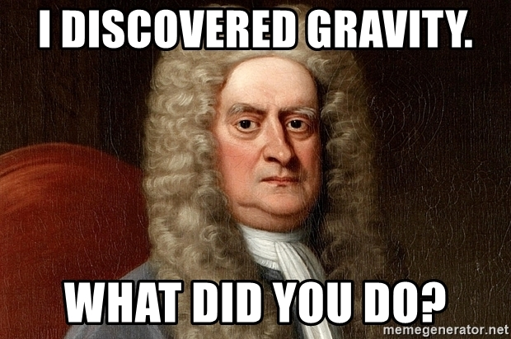
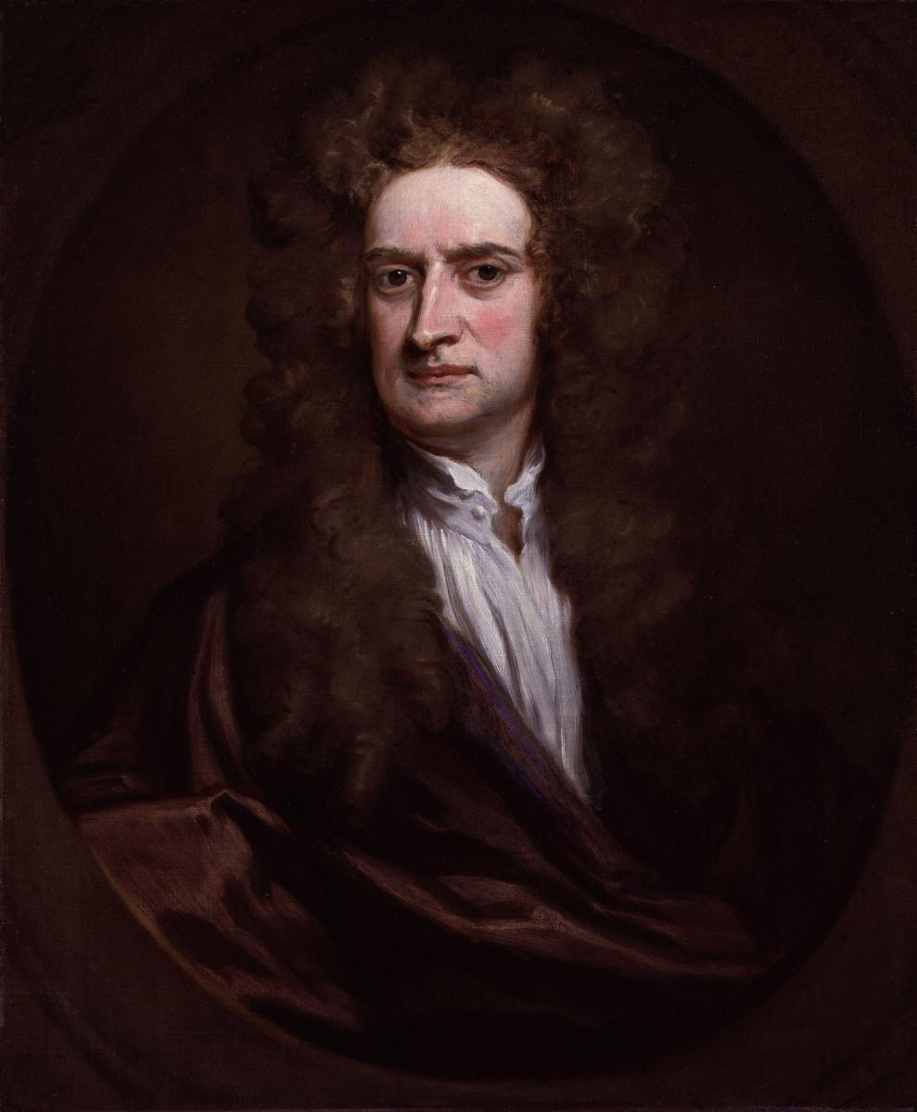
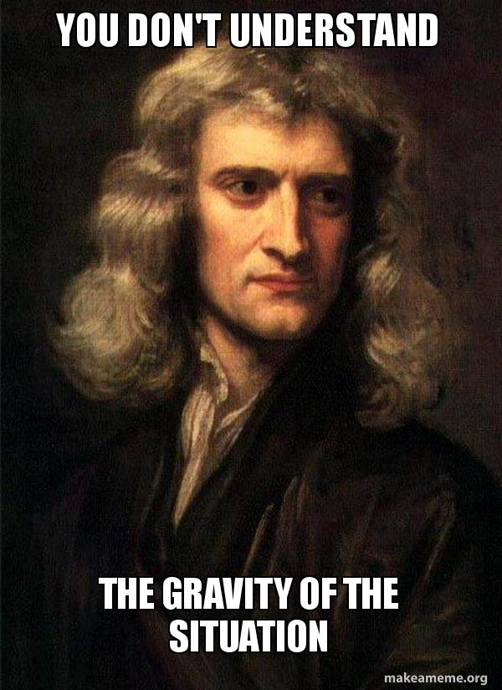
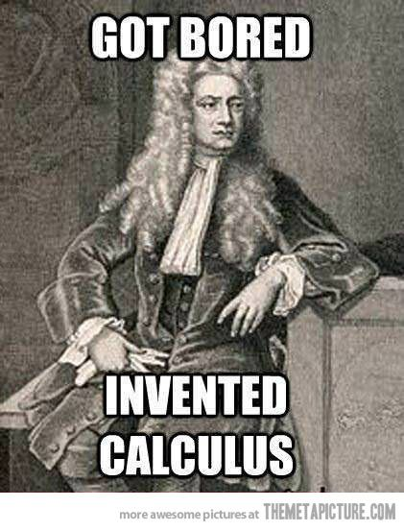
Isaac Newton

Slide 11
Dr. CK’s Takeaway
Only through prayer, acceptance, and guidance of the Holy Spirit can we overcome the sins of Anxiety, Frustration, and Discontentment.
Trust God
Anonymous quote:
Lord, I am willing to - -
Receive what you give,
Lack what you withhold,
Relinquish what you take.

