Slide 1
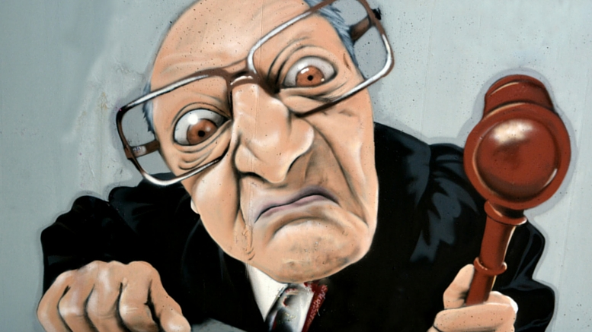
Judgmentalism

Slide 2
What does it mean to Judge Someone?
It is easy to become judgmental towards anyone who has a different opinion than ours
We judge people by:
The Way they Dress (church and other places)
Their actions and behaviors
The way they talk
The way they walk
In relation to our own experiences
Degrees
Cultural Differences
What they eat
How much makeup they put on
Something they did wrong
Something they did right
Their Age
Your Thoughts?

Slide 3
Judgmentalism
We sin when we develop an attitude of self-righteousness or we judge harshly or a spirit of censoriousness
We sin if we condemn the obvious flagrant sins of other without at the same time acknowledging that we ourselves are still sinners before God

Slide 4
Romans 14:1-12
The Danger of Criticism
14 Accept other believers who are weak in faith, and don’t argue with them about what they think is right or wrong. ² For instance, one person believes it’s all right to eat anything. But another believer with a sensitive conscience will eat only vegetables. ³ Those who feel free to eat anything must not look down on those who don’t. And those who don’t eat certain foods must not condemn those who do, for God has accepted them. ⁴ Who are you to condemn someone else’s servants? Their own master will judge whether they stand or fall. And with the Lord’s help, they will stand and receive his approval.
⁵ In the same way, some think one day is more holy than another day, while others think every day is alike. You should each be fully convinced that whichever day you choose is acceptable. ⁶ Those who worship the Lord on a special day do it to honor him. Those who eat any kind of food do so to honor the Lord, since they give thanks to God before eating. And those who refuse to eat certain foods also want to please the Lord and give thanks to God. ⁷ For we don’t live for ourselves or die for ourselves. ⁸ If we live, it’s to honor the Lord. And if we die, it’s to honor the Lord. So whether we live or die, we belong to the Lord. ⁹ Christ died and rose again for this very purpose—to be Lord both of the living and of the dead.
¹⁰ So why do you condemn another believer^{[a]}? Why do you look down on another believer? Remember, we will all stand before the judgment seat of God. ¹¹ For the Scriptures say,
“‘As surely as I live,’ says the Lord, ‘every knee will bend to me, and every tongue will declare allegiance to God.^{[b]}’”
¹² Yes, each of us will give a personal account to God. ¹³ So let’s stop condemning each other. Decide instead to live in such a way that you will not cause another believer to stumble and fall.

Slide 5
John 3:16-21
¹⁶ “For this is how God loved the world: He gave^{[g]} his one and only Son, so that everyone who believes in him will not perish but have eternal life. ¹⁷ God sent his Son into the world not to judge the world, but to save the world through him.
¹⁸ “There is no judgment against anyone who believes in him. But anyone who does not believe in him has already been judged for not believing in God’s one and only Son. ¹⁹ And the judgment is based on this fact: God’s light came into the world, but people loved the darkness more than the light, for their actions were evil. ²⁰ All who do evil hate the light and refuse to go near it for fear their sins will be exposed. ²¹ But those who do what is right come to the light so others can see that they are doing what God wants.^{[h]}”

Slide 6
Revelation 20:11-15
Judgment at the Throne of God
¹¹ Then I saw a great white throne and Him who sat upon it, from whose ^{[g]}presence earth and heaven fled, and no place was found for them. ¹² And I saw the dead, the great and the small, standing before the throne, and ^{[h]}books were opened; and another ^{[i]}book was opened, which is the book of life; and the dead were judged from the things which were written in the ^{[j]}books, according to their deeds. ¹³ And the sea gave up the dead who were in it, and Death and Hades gave up the dead who were in them; and they were judged, each one of them according to their deeds. ¹⁴ Then Death and Hades were thrown into the lake of fire. This is the second death, the lake of fire. ¹⁵ And if ^{[k]}anyone’s name was not found written in the book of life, he was thrown into the lake of fire.

Slide 7
Revelation 1:1-8
The New Heaven and Earth
21 Then I saw a new heaven and a new earth; for the first heaven and the first earth passed away, and there is no longer any sea. ² And I saw the holy city, new Jerusalem, coming down out of heaven from God, prepared as a bride adorned for her husband. ³ And I heard a loud voice from the throne, saying, “Behold, the tabernacle of God is among the people, and He will dwell among them, and they shall be His ^{[a]}people, and God Himself will be among them^{[b]}, ⁴ and He will wipe away every tear from their eyes; and there will no longer be any death; there will no longer be any mourning, or crying, or pain; the first things have passed away.”
⁵ And He who sits on the throne said, “Behold, I am making all things new.” And He *said, “Write, for these words are faithful and true.” ⁶ Then He said to me, “^{[c]}It is done. I am the Alpha and the Omega, the beginning and the end. I will give water to the one who thirsts from the spring of the water of life, without cost. ⁷ The one who overcomes will inherit these things, and I will be his God and he will be My son. ⁸ But for the cowardly, and ^{[d]}unbelieving, and abominable, and murderers, and sexually immoral persons, and sorcerers, and idolaters, and all liars, their part will be in the lake that burns with fire and ^{[e]}brimstone, which is the second death.”

Slide 8
Conclusion
God will judge every sin, and He will judge every sin no matter who you are (2 Tim 4:1; Rom 2).
Jesus teaches us to — in love — tell fellow believers about their sins. In John 7, Jesus states that we should “judge with right judgment” and not “by appearances” (John 7:14). The meaning of this is that we should judge biblically, not worldly.
Christians Must Judge - Scripture specifically instructs Christians to judge other Christians. In 1 Corinthians 5, Paul commands the church “not to associate with sexually immoral people,” which to obey, requires making a judgment. He further writes, “Are you not to judge those inside (the church)? . . . ‘Expel the wicked person from among you.’” So not only should Christians judge other believers, they should also discipline them based on those judgments. Similarly, Jesus says in John 7:24, “Stop judging by mere appearances, but instead judge correctly.” Clearly, Jesus expects us to judge, but simply wants us to judge correctly, using proper standards.
Don’t Apply a Double-Standard The solution isn’t to refrain from judging; it’s to fix yourself so you can help fix others.
Seek to Restore - So when we make judgments, we must do so humbly. And we must do so with the intent of helping our brother or sister escape sin and the destruction it wreaks, not to elevate ourselves.

