Slide 1
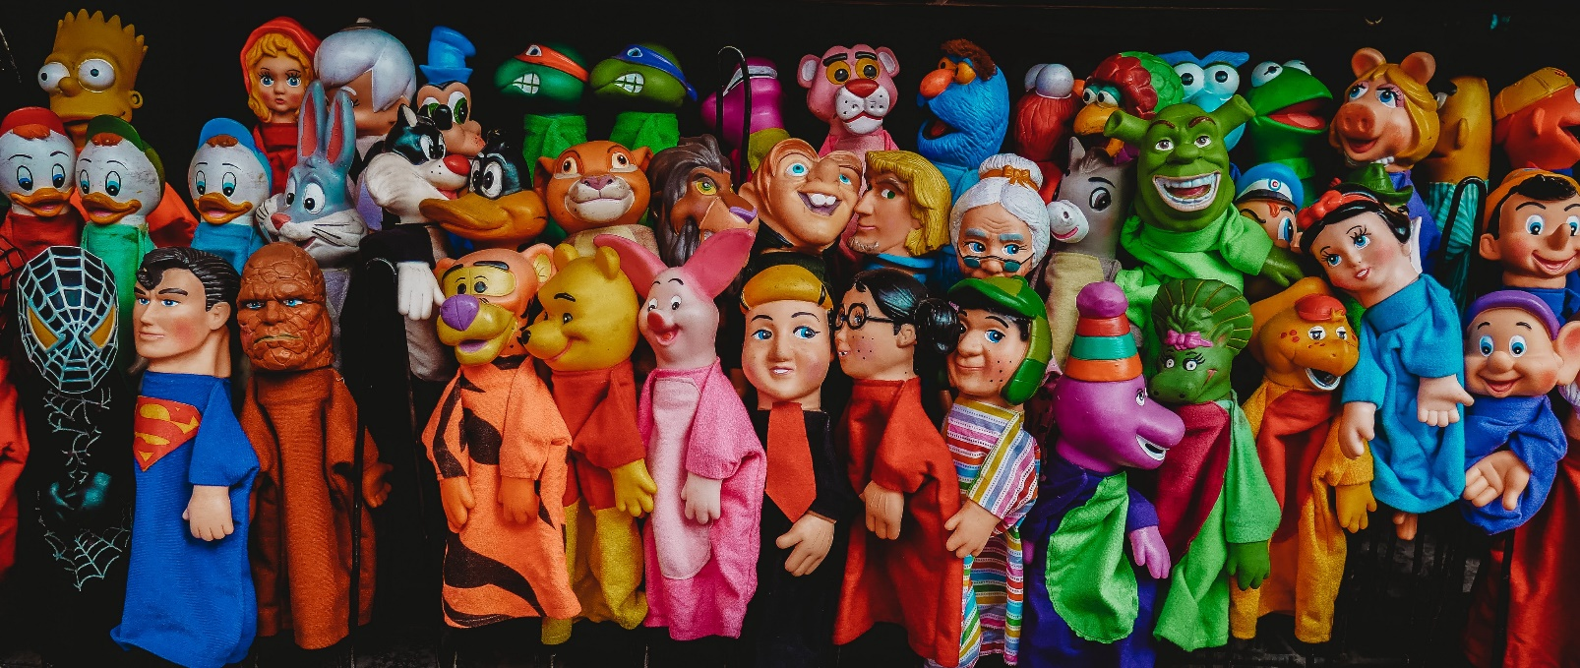
What is the One Fictional Character you wish was a real person?

Slide 2
QUESTION
What movie or book does everyone love that you don’t like at all?

Slide 3
Do I have to Grow Up?
What do you want to be when you grow up?

Slide 4
HOT SEAT
What is your favorite road trip snack?
Three APPS on your phone/PC you cannot live without?
What is one thing you are passionate about?
Who is the Bomb Diggity?
How much wood could a woodchuck chuck if a woodchuck could chuck wood?

Slide 5
Make an Impact

Slide 6
Acts 1:1-11
God Speaks
God Commands / We should Listen
Pray for Holy Spirit Guidance
Be A Witness
Jesus Promised to Return an continue making His Impact

Slide 7
4 Ways to Make an Impact Matthew 9:35-38
See as Jesus See’s
Feel as Jesus Feels
Pray As Jesus Prays
Do as Jesus Does

Slide 8
Overall
We have to be driven by the Mission of God
When we live like we have a sincere relationship with God, we can help others do the same!!!

Slide 9
Jeremiah
The reason for the failure of the Deuteronomic reformation was to be found not in the character of the laws but rather in the motives that were dominant in the lives of the people. The prophet's conception of human nature is well expressed in his statement "Can the Ethiopian change his skin or the leopard its spots? Neither can you do good who are accustomed to doing evil." Humans are so constituted that they follow their desires rather than their intellect; for this reason, they cannot change their evil ways until they experience a change of heart. Furthermore, Jeremiah contended that humans cannot change their nature by themselves. Such reform can occur only through cooperation with Yahweh, and Yahweh can act on human hearts only when humans recognize their need for it. Without this inner transformation in human nature, all reformative movements are destined to fail.

Slide 10
Jeremiah
Jeremiah declares, "I will put my law in their minds and write it on their hearts. I will be their God, and they will be my people." Jeremiah concludes by saying that when this is done, specific rules no longer will be necessary in order for people to know how they ought to behave. With changed natures and the right desires present within them, people will know what is the morally correct thing to do in any situation.

