Slide 1
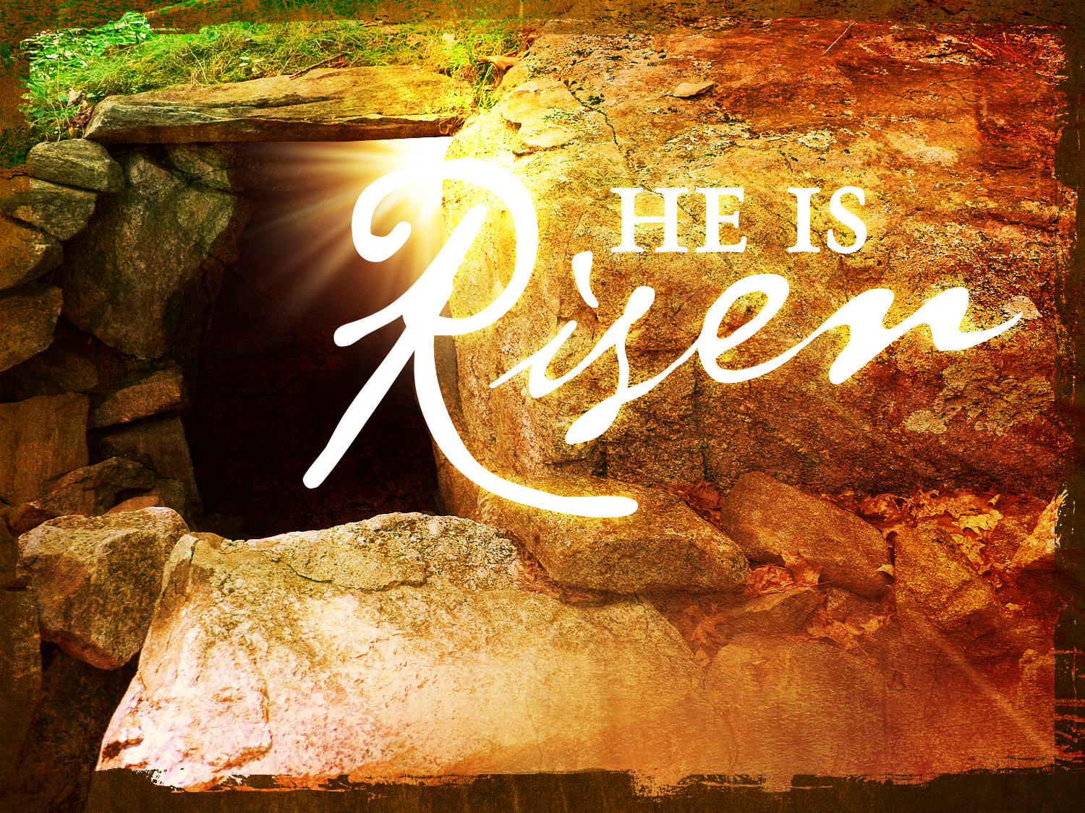

Slide 2
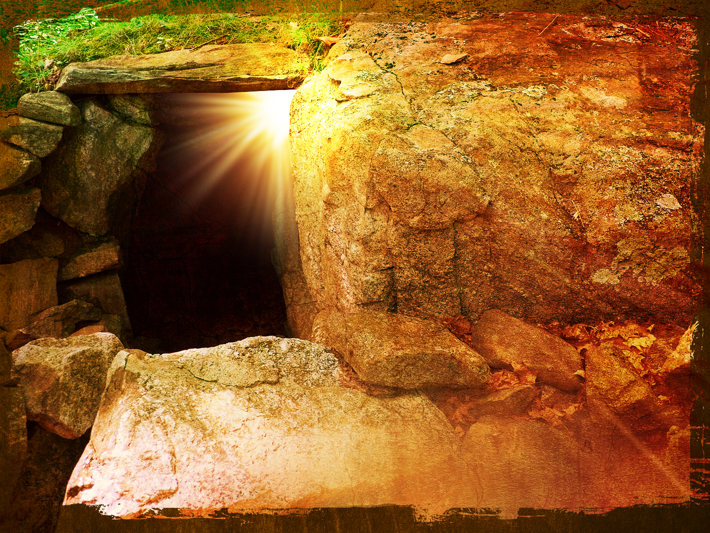
Waiting on a
Miracle

Slide 3
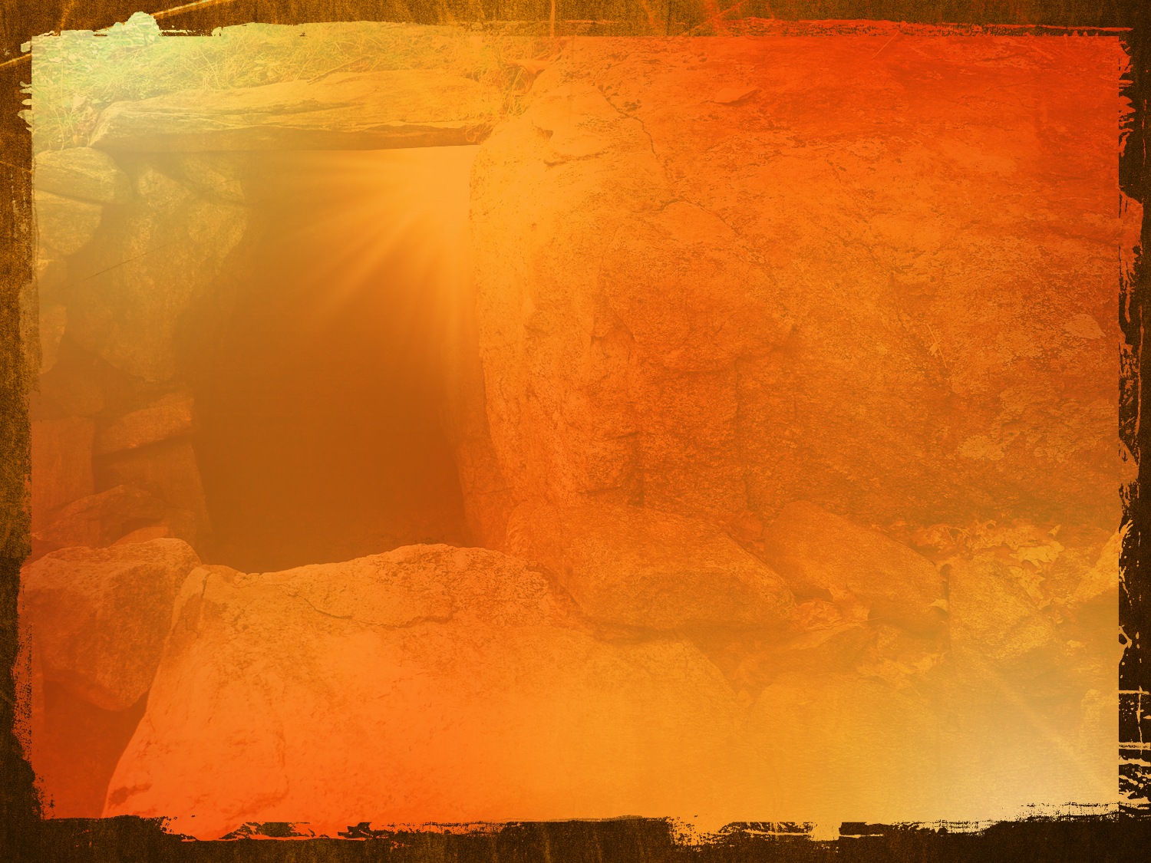
What does the Resurrection mean for you?
Resurrection – “Anastasis”
To Recover from a debilitating condition
Rebirth
Rising of the Dead as it pertains to JESUS & ALL who
accept Him at the end of the church age

Slide 4
The Fact of Christ’s Resurrection
1 Corinthians 15:1-11
15 Now I make known to you, brothers and sisters, the gospel which I preached to you, which you also received, in which you also stand, ² by which you also are saved, if you hold firmly to the word which I preached to you, unless you believed in vain.
³ For I handed down to you as of first importance what I also received, that Christ died for our sins according to the Scriptures, ⁴ and that He was buried, and that He was raised on the third day according to the Scriptures, ⁵ and that He appeared to Cephas, then to the twelve. ⁶ After that He appeared to more than five hundred brothers and sisters at one time, most of whom remain until now, but some have fallen asleep; ⁷ then He appeared to James, then to all the apostles; ⁸ and last of all, as to one untimely born, He appeared to me also. ⁹ For I am the least of the apostles, and not fit to be called an apostle, because I persecuted the church of God. ¹⁰ But by the grace of God I am what I am, and His grace toward me did not prove vain; but I labored even more than all of them, yet not I, but the grace of God with me. ¹¹ Whether then it was I or they, so we preach and so you believed.

Slide 5
JOHN 11:23-27 / 40-44
²³ Jesus *said to her, “Your brother will rise from the dead.” 24 Martha *said to Him, “I know that he will rise in the resurrection on the last day.” 25 Jesus said to her, “I am the resurrection and the life; the one who believes in Me will live, even if he dies, 26 and everyone who lives and believes in Me will never die. Do you believe this?” 27 She *said to Him, “Yes, Lord; I have come to believe that You are the Christ, the Son of God, and He who comes into the world.”
40 Jesus *said to her, “Did I not say to you that if you believe, you will see the glory of God?” 41 So they removed the stone. And Jesus raised His eyes, and said, “Father, I thank You that You have heard Me. 42 But I knew that You always hear Me; nevertheless, because of the people standing around I said it, so that they may believe that You sent Me.” 43 And when He had said these things, He cried out with a loud voice, “Lazarus, come out!” 44 Out came the man who had died, bound hand and foot with wrappings, and his face was wrapped around with a cloth. Jesus *said to them, “Unbind him, and let him go.”

Slide 6
Are you waiting on a miracle?
Are you bound to this world, bound to sin, no hope, in debt, sick, dying even?
Jesus is crying out to you,… “COME FORTH!” / “COME OUT” – from the world to the Lord
Live unbound, freed, and unwrap the miracles, gifts, and life Jesus offers and wants for you!!

Slide 7
JESUS
WILL
RETURN
REsurrection = REturn

Slide 8
To
Be
Continued…

